Slide 1
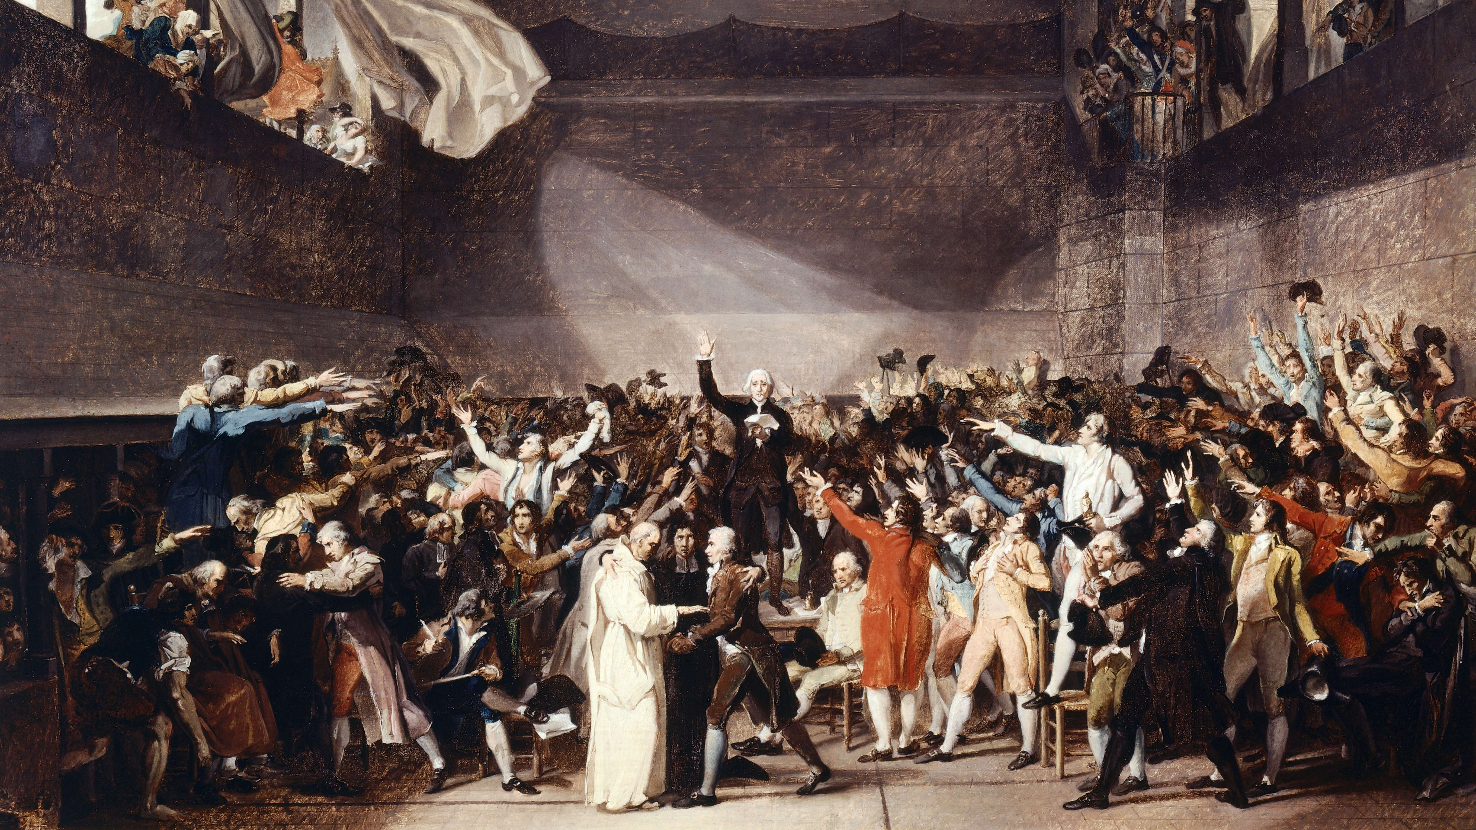
Governmentality, Cartography, and Making Societies Legible
Dr Oliver Belcher
Geographies of Power III
8 February, 2018

Slide 2
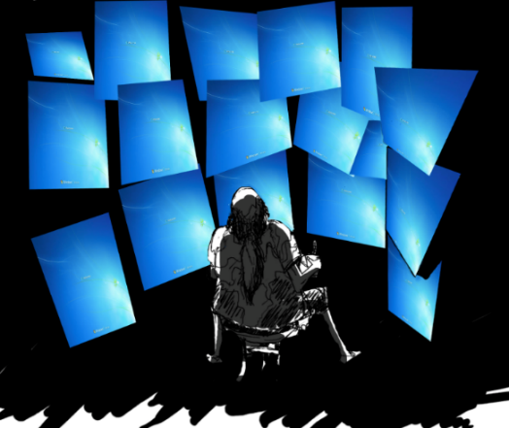
Next week: Tutorials!
Read: Leszczynski, A. 2015. “Spatial Big Data and Anxieties of Control” Environment and Planning D: Society and Space 33(6): 965-984
Read: “Reinventing Society in the Wake of Big Data: A Conversation with Alex (Sandy) Pentland” https://www.edge.org/conversation/reinventing-society-in-the-wake-of-big-data
Bring to the tutorial: TWO news articles on the Investigatory Powers Act, or any U.K. based data-related surveillance article (e.g., the bulk collection of data allowed by the Telecommunications Act)

Slide 3
Today’s Outline
Foucault’s concept of “governmentality”
Government: the “conduct of conduct”
What does it mean? What is the historical background? Why is it relevant for geography?
Governmentality and Geography: mapping, aerial photography, and social space

Slide 4
Definitions: Government
Short definition: “The conduct of conduct”
What do we mean by conduct?
To lead, direct, guide
Calculation as to how something is going to get done
Ethical/moral sense: ‘to conduct one’s self’ (reflexive verb)
Behaviours, actions, comportment (noun) → evaluative, normative
E.g., “professional conduct”
Presumes that behaviours can be regulated or controlled (rationally)
Agents in place who ensure regulation occurs
Government: any attempt to shape with some degree of deliberation aspects of our behaviour according to a particular set of norms and for a variety of ends.
Assumes a plurality of governing agencies and authorities targeting aspects of behaviour, norms, purposes, outcomes, consequences

Slide 5
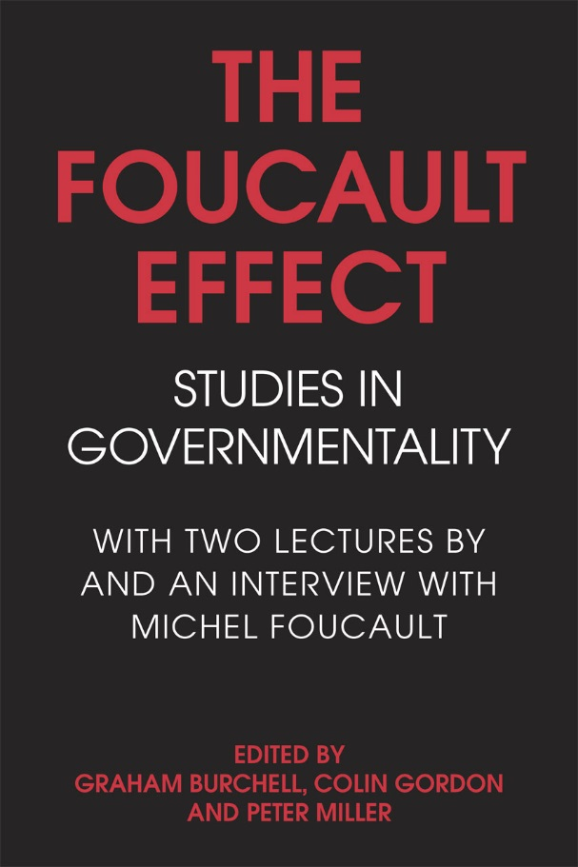

Definitions: Government
“Government is any more or less calculated activity and rational activity, undertaken by a multiplicity of authorities and agencies, employing a variety of techniques and forms of knowledge, that seeks to shape conduct by working through our desires, aspirations, interests, and beliefs, for definite but shifting ends and with a diverse set of relatively unpredictable consequences, effects, and outcomes.”
Mitchell Dean (1999: 11)
Analysis of government: analysing practices that try to shape, sculpt, mobilize and work through the choices, desires, aspirations, needs, wants, and lifestyles of individuals and groups.

Slide 6
Definitions: Governmentality
What do we mean by governmentality?
First sense: How do we think about governing, different mentalities of governing?
Thinking as a collective activity
Mentality as collective form of thought, difficult to comprehend within its own perspective
Mentalities of government: thought involved in practices of government is collective and taken for granted; not usually open to question by practitioners.

Slide 7


Easy example: Diet and “self-government”
Diet: The government of conduct around eating and drinking
Knowledge/expertise base: dieticians, health professionals, diet fads, religious or spiritual beliefs
Technologies of the self: counting calories, tracking steps, exercise, cleanse, proscribed foods from religious beliefs, purifying one’s soul
Reasons: Better body, heart disease, ethics (animals, climate), taboos
New forms of knowledge: correlation between energy and intake of particular foods/exercise
Tacit presupposition of the mentality: practice of self-denial necessary to purify one’s self, soul, or even society

Slide 8


Analysis of diet and “self-government”
Ontology: what we seek to act upon, the governed or ethical substance (soul, body, the flesh in Christianity, pleasures in Ancient Greece)
Ascetics: how we govern the substance, governing or ethical work (routines, apps, journals, procedures of surveillance, management, etc.).
Deontology: who we are when we are governed in such a manner, mode of “subjectification,” governed or ethical subject
Teleology: why we govern or are governed → ends or goals sought, what we hope to become, world we hope to create; telos of governmental or ethical practices (six-pack abs; better person; more ‘in tune’ with environment and food system; better mood management, etc.)

Slide 9


Power, Truth, and Identity
Key point: government (‘conduct of conduct’) entails not only relations of power and authority, but also issues of self and identity.
Three dimensions:
Power (techne)
Truth (episteme) – bound up with practices
Identity (ethos)

Slide 10
Definitions: Governmentality
What do we mean by governmentality?
Second sense: marks a new form of thinking about and exercising power in society.
Government takes population as its object(ive) – health, wealth, prosperity, happiness
Special relationship with sovereignty and discipline
Modern form of authority: “Sovereignty—discipline—government” series
Population enframed in “apparatuses of security”
Standing armies, police, diplomatic corps, intelligence spies
Health, education, social welfare

Slide 11
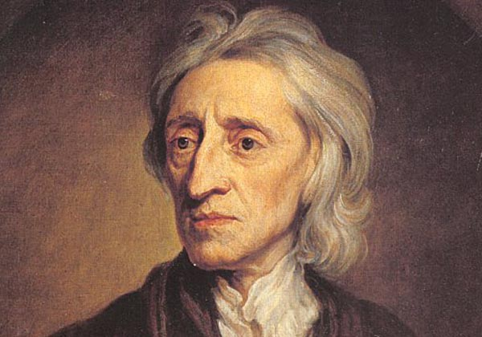
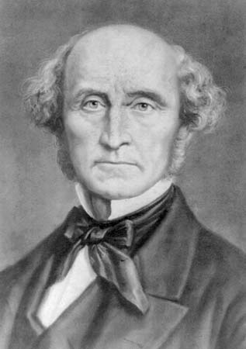
Liberalism and the Economy
What is liberalism? At bottom, a critique of excessive government.
Political philosophy: limited gov’t with respect to rights/liberties of citizens; employs rule of law
Democratized form of sovereignty
Locke, Smith, Mill, etc.
Art of government: uses capacities of free subjects as among the means to achieve purposes and goals.
Shapes capacities via discipline and biopolitics
Neo-liberalism: problematizes welfare state; recommends reforms of individual and institutional conduct to produce more competitive/efficient subjects; seeks reform through market mechanisms → emphasis on “choice”
John Locke
John Stuart Mill

Slide 12
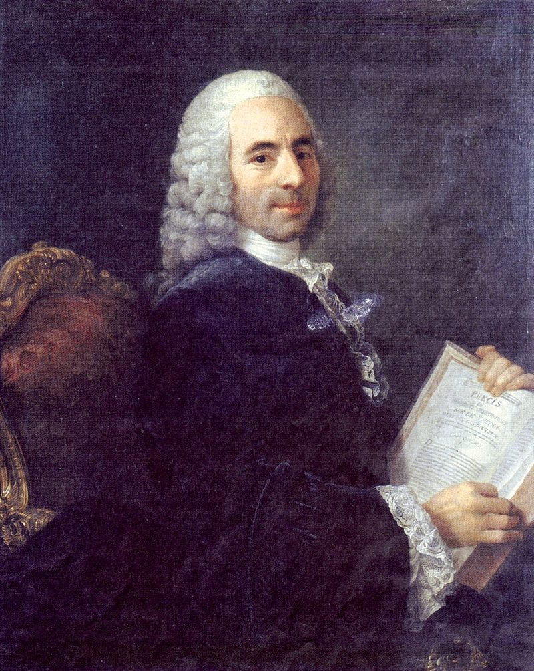
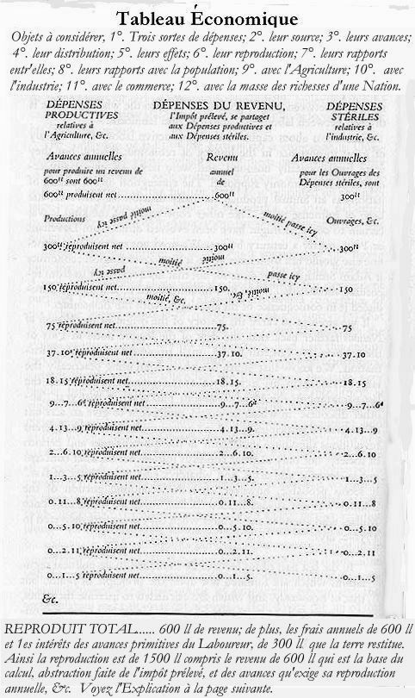
Emergence of “Economy” and Markets
18th century: discovery of the economy as having a “quasi-nature” that could be represented.
Francois Quesnay and Physiocrats
Ontology (what): Natural order prior to any state of affairs established by government
Land agriculture, land development as source of wealth
How: fiscal policy to modify/intervene in source of wealth
Table: abstract representation to know totality of exchanges between economic actors
Intended to enlighten sovereign, so activities can be monitored.
Economy, wealth, and trade no longer constituted by existence of sovereign, but operates independently of sovereign action.
Francois Quesnay

Slide 13
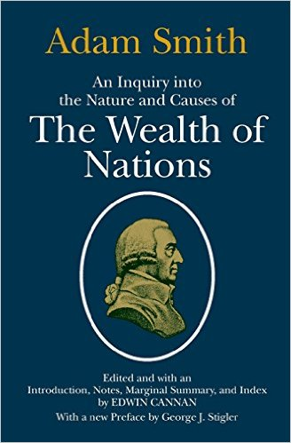
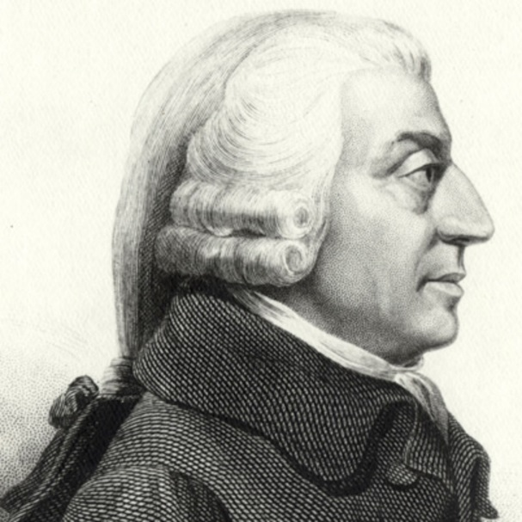
Emergence of “Economy” and Markets
18th-19th Century: Adam Smith’s The Wealth of Nations
Quesnay’s Table to make economic relations visible vs. Smith’s invisible hand
Presupposes intrinsic invisibility between individual profit-seeking and the growth of collective/common wealth
Foucault: “benign opacity of economic processes”
Economy: pursuit of individual self-interest in the exchanges of the market
Implication: Impossibility of economic sovereignty
sovereign cannot determine how free individuals maximize wealth.
Smith argued applies to moral, political, and economic concerns.

Slide 14
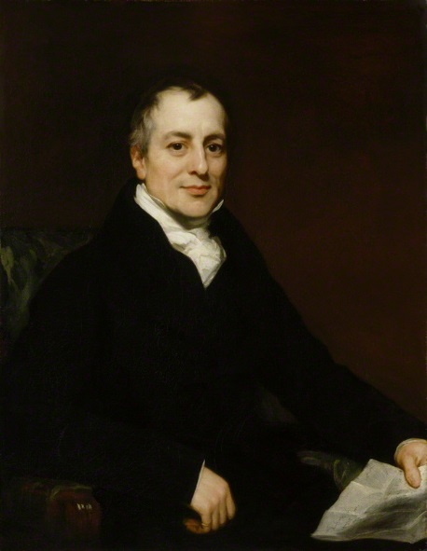
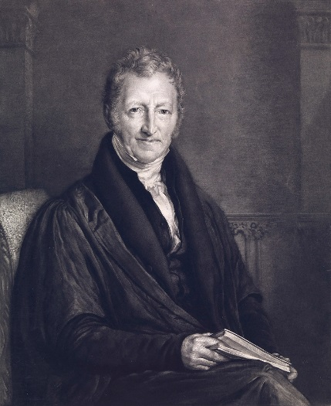
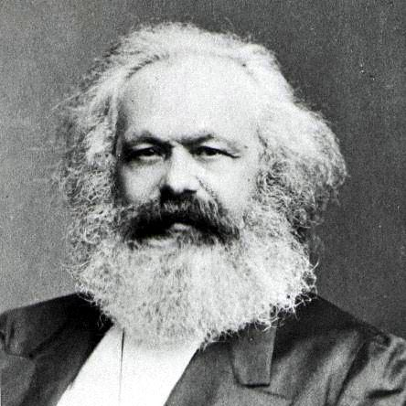
Emergence of “Economy” and Markets
19th century: David Ricardo and Thomas Malthus
Economy as bio-economic reality
i.e., natural disequilibrium between subsistence and population
Ricardo: differential theory of rent vs. Smith’s invisible hand of self-interest
Economy concerns humankind’s struggle to bring lands into cultivation, to increase productivity of labor, to defeat natural scarcity due to “laws” of population
Sovereignty: Makes regulations needed to account for natural processes external to it (e.g., laws of population)
Biopolitics of population as living, organic entity
Marx: problem is a matter of distribution (class struggle between bourgeoisie vs. proletariat), rather than “natural” ontological scarcity
Liberalism: ideology of the state/civil society
Although, Marx believed market had its own (natural) laws! Saw himself as a scientist.
David Ricardo
Thomas Malthus
Karl Marx

Slide 15

Liberalism and the Economy
What is liberalism? At bottom, a critique of excessive government.
Political philosophy: limited gov’t with respect to rights/liberties of citizens; employs rule of law
Democratized form of sovereignty
Locke, Smith, Mill, etc.
Art of government: uses capacities of free subjects as among the means to achieve purposes and goals.
Shapes capacities via discipline and biopolitics
Neo-liberalism: problematizes welfare state; recommends reforms of individual and institutional conduct to produce more competitive/efficient subjects; seeks reform through market mechanisms → emphasis on “choice”

Slide 16
Questions?
Break (10 minutes)

Slide 17
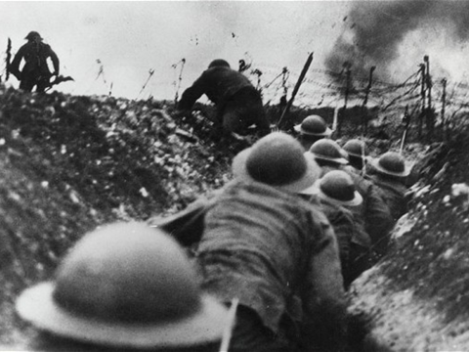

Slide 18
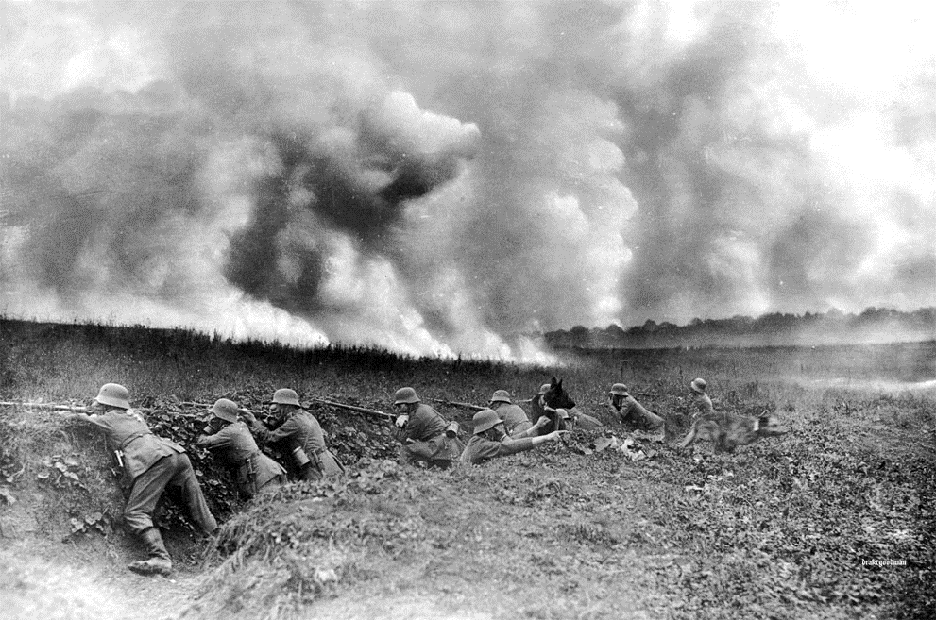

Slide 19
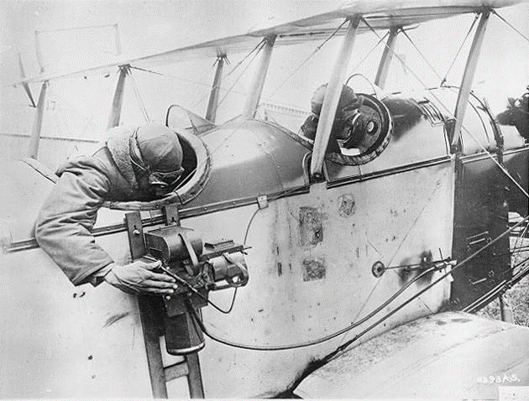
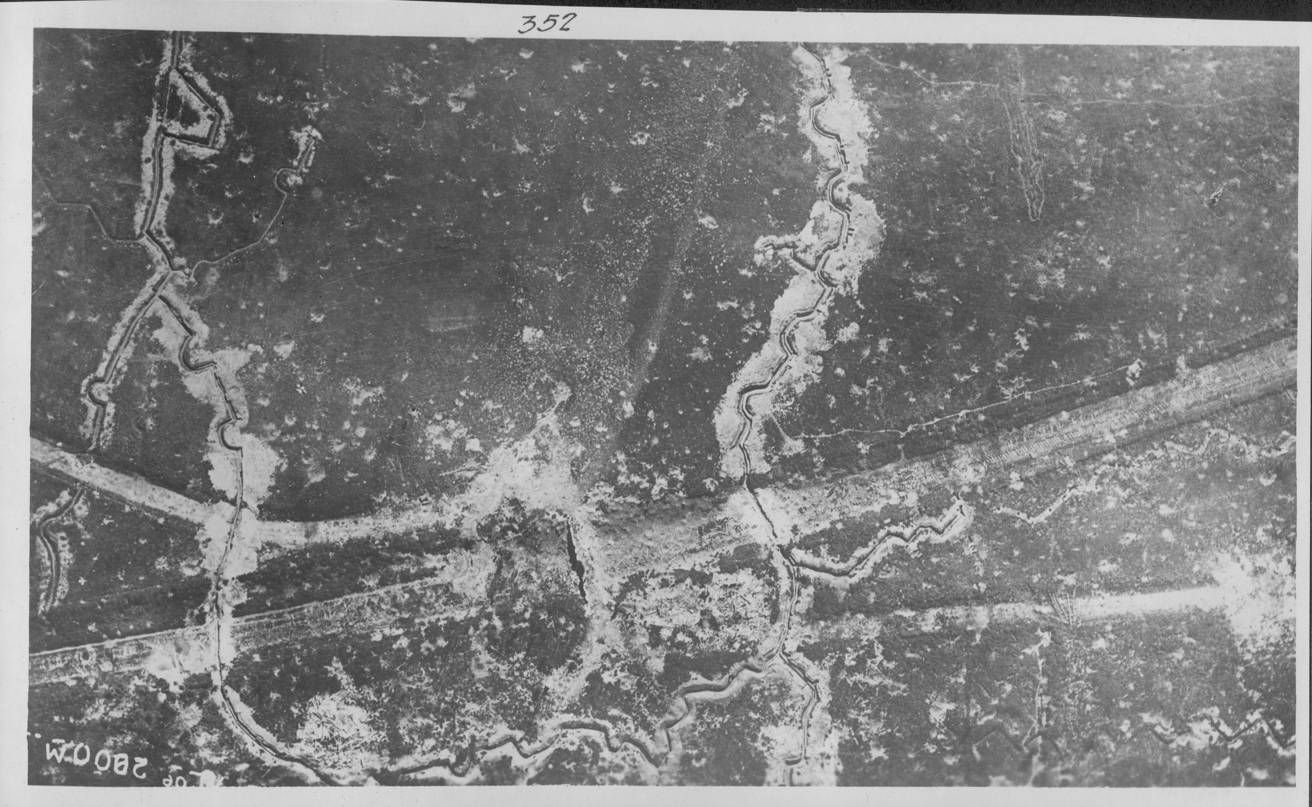
World War I and the View From Above

Slide 20


WWI, the View from Above, and “Displacing the Eye”
“Complete destruction of traditional fields of perception… As sight lost its direct quality and reeled out of phase, the soldier had the feeling of being not so much destroyed as derealized or dematerialized, any sensory point of reference suddenly vanished in a surfeit of optical targets.”
Paul Virilio, War and Cinema (1989)
“The emergence of the cold and dispassionate view of the artificial eye of the camera was simultaneously a process of decomposition of the individual… New era marked by a deep connection between new machines and a new type of man.”
Ernst Jünger, “On Pain” (1934)

Slide 21
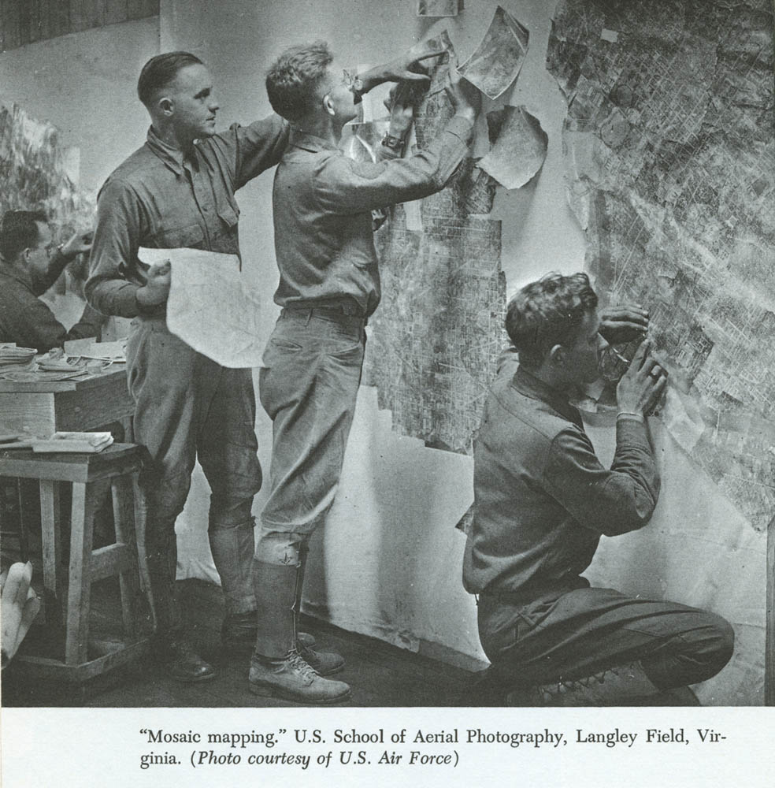
The View from Above
“So much information that would otherwise have been concealed from the enemy was revealed by the all-seeing lens… No matter how carefully machine-gun emplacements may have been concealed, their position was often betrayed by the disclosure of foot tracks made over-night to and from munitions dumps. Dummy trenches… were detected easily enough, for the absence of shadow on the completed footprints was sufficient to arouse suspicion… [the enemy’s] possible future activities (as well as past and present) were laid before the Allies like an open book.”
Winchester and Willis, 1928, on First World War aerial reconnaissance

Slide 22
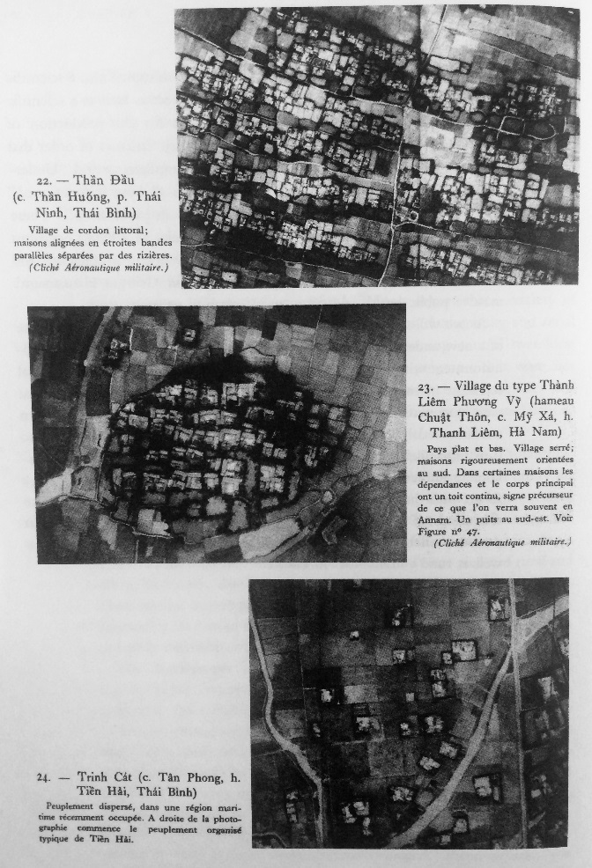
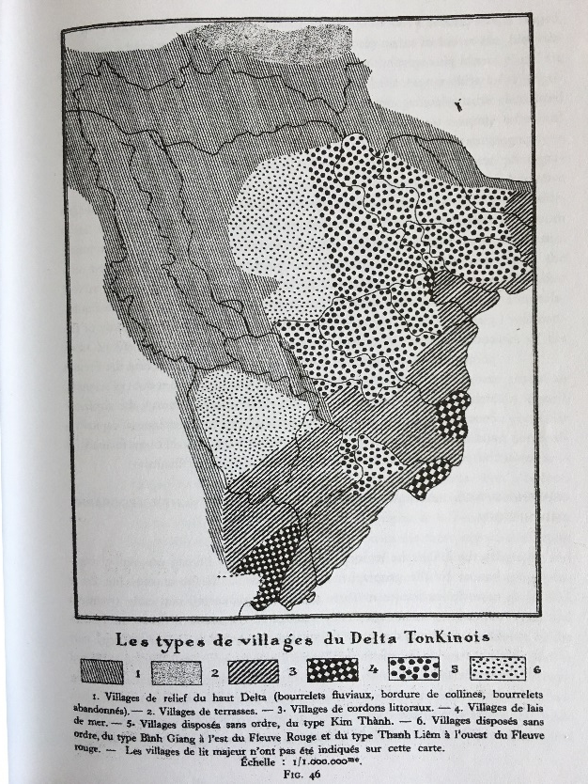
Pierre Gourou and “ethnography from the air”
Pierre Gourou, French Anthropologist
The Peasants of Tonkin Delta (1936)
Seemingly chaotic villages from the ground revealed a “distinct and abstract form” from the air
Abstract forms revealed autonomous nature of political, economic, social life on the ground in north Vietnam
What appeared to Western eyes as chaotic from the ground was extremely well-ordered, as seen from above.

Slide 23
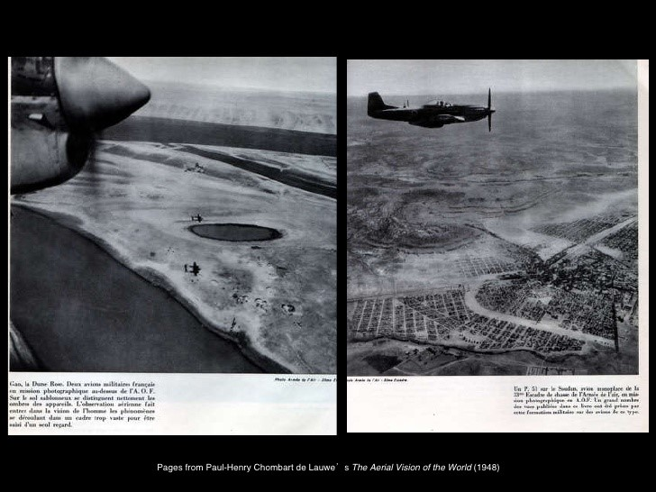
The View from Above and the City
[Spectator’s “privileged view” of Paris]: “The Tower’s verticality permits us to transcend sensation and to see things in their structure, granting us access, in a single glance, to the city’s blueprint or x-ray and to something like its deep time.”
Roland Barthes, “The Eiffel Tower” (1979)
“From the air it is the links in the landscapes, the rivers, roads, railways, canals, pipe-lines, electric cables, rather than the breaks that impress the aviator… regional geographers may be trying to put boundaries that do not exist around areas that do not matter.”
Richard Kimble, 1951

Slide 24
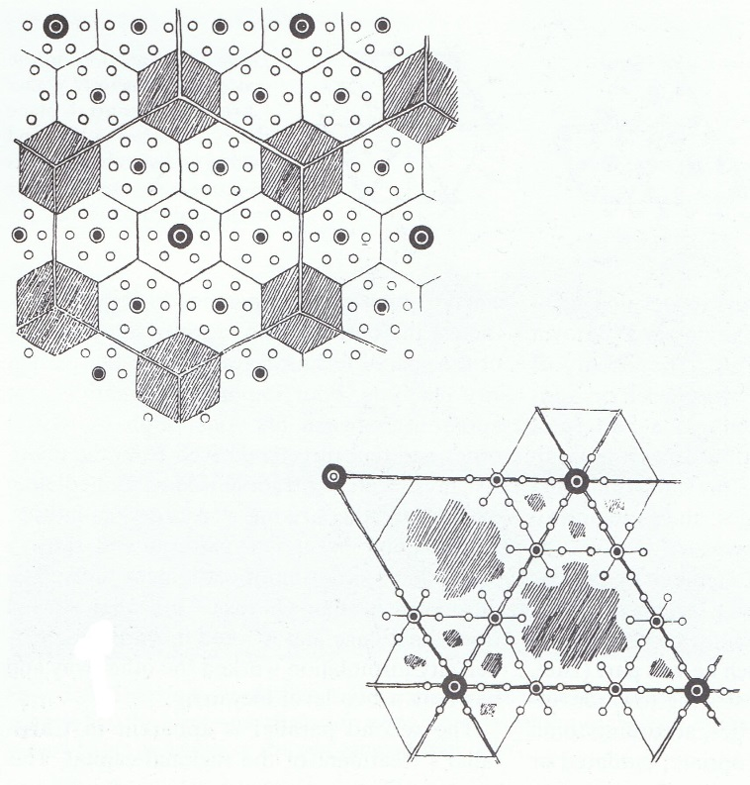
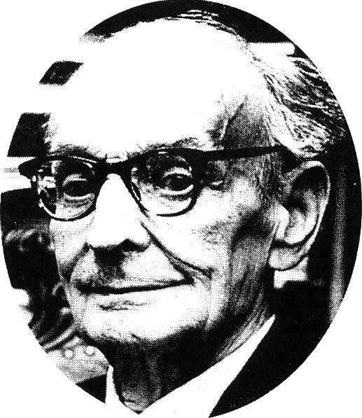
Effects of View from Above (1): Spatial Science
Tobler’s ‘First Law of Geography’: “Everything is related to everything else, but near things are more related than distant things”
“The stronger and more purely the location, form and size express the centralistic character of such community buildings, the greater is our aesthetic pleasure, because we acknowledge that the congruence of purpose and sense with the outer form is logically correct and therefore can be recognized as clear.”
Walter Christaller
Walter Christaller (1893-1969)

Slide 25
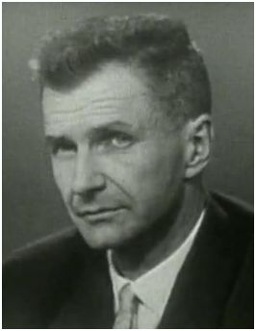
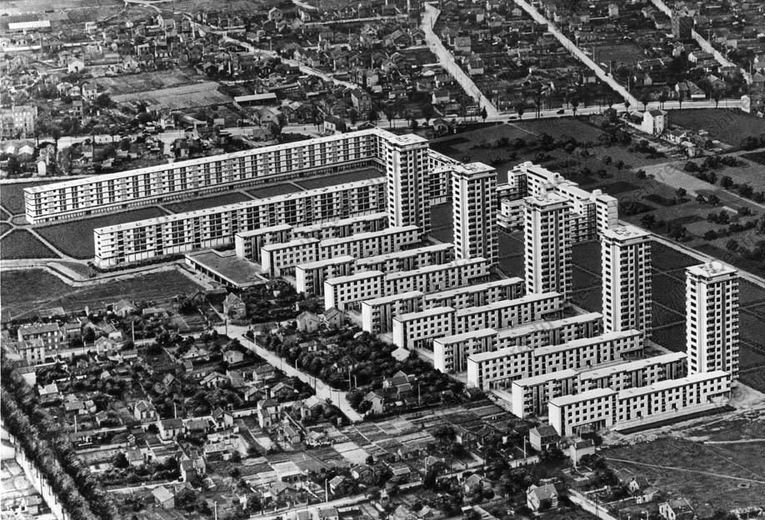
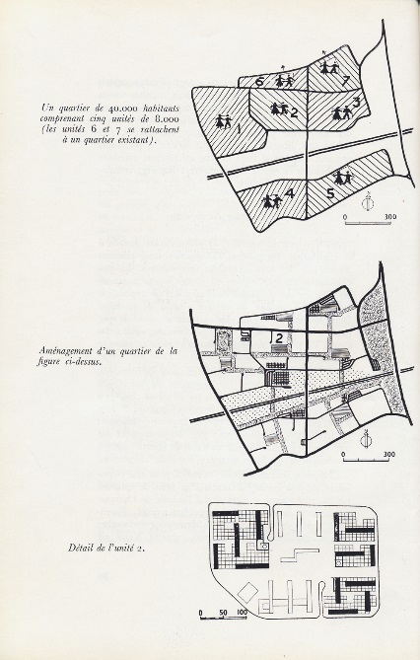
Effects of View from Above (II): Social Space
Paul-Henry Chombart de Lauwe: Coined the term “social space” (l’espace social)
Claim: Aerial photos of physical form of neighborhoods in Paris reflected social and economic character
“We need, in the city of Paris, to examine the situation of populations such as the one of suburban projects, who find themselves cut from vital centers and feel for that reason outside of the national life.”
Chombart and colleagues embraced social-scientific study of “social space”
Social space could frame social problems of grand ensembles in a new light → address alienation, isolation
Relied on aerial photography and ethnographic methods to model the relationships of inhabitants.
Aerial photos draw attention to overall all form of urban area, it’s relationships.

Slide 26
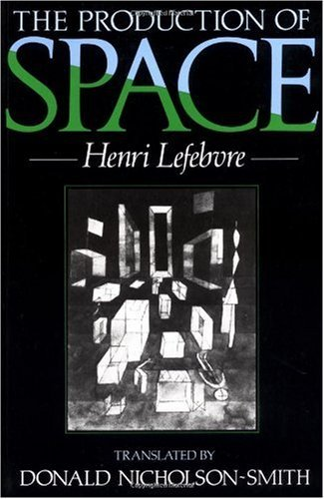
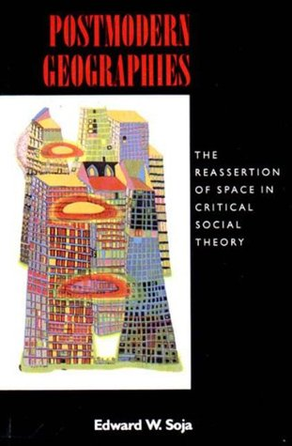
“Socio-spatial Dialectic”
“(Social) space is a (social) product… social space ‘incorporates’ social actions.”
Henri Lefebvre, The Production of Space
“The structure of organized space is not a separate structure with its own autonomous laws of construction and transformation, nor is it simply an expression of the class structure emerging from the social (i.e., aspatial) relations of production. It represents, instead, a dialectically defined component of the general relations of production, relations which are simultaneously social and spatial.”
Edward Soja, Postmodern Geographies

Slide 27
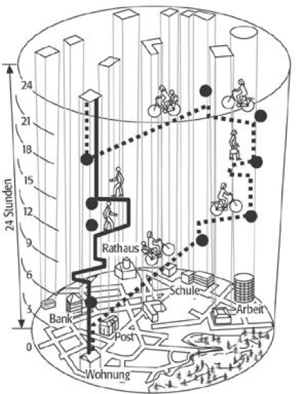
Torsten Hagerstrand’s “Time Geography” Model
Mid-1960s

Slide 28
Next week!
Tutorials!
Next block: Political Geographies of the Anthropocene

